Slide 1

Design Review on Major Project
CampusIQ: An AI-Powered University Student Support and Academic Intelligence Platform
Presented By :
23R21A6754 – Shaik Abdul Kareem Ayemen
23R21A6704 – Sai Krishna
23R21A6755 – Shaik Sameer Basha
Under the guidence of :
MRS. ARSHIYA BEGUM
ASSISTANT PROFESSOR
DEPT. OF CSE- DATA SCIENCE
MLRIT

Slide 2
PROBLEM STATEMENT & OBJECTIVES
Problem Statement:
Students face difficulties accessing accurate academic and administrative information scattered across multiple university resources.
Objectives:
1. To implement an AI chatbot using RAG and semantic search for natural-language queries.
2. To develop a centralized platform for accessing academic and administrative information.
3. To provide personalized academic guidance and eligibility analysis using authorized student data.
4. To deliver timely notifications, examination updates, and academic reminders.
5. To enable efficient grievance submission, tracking, and administrative support.
6. To ensure secure access to institutional information through authentication and role-based access control.
7. To provide reliable, source-based AI responses while minimizing inaccurate or unsupported information.

Slide 3
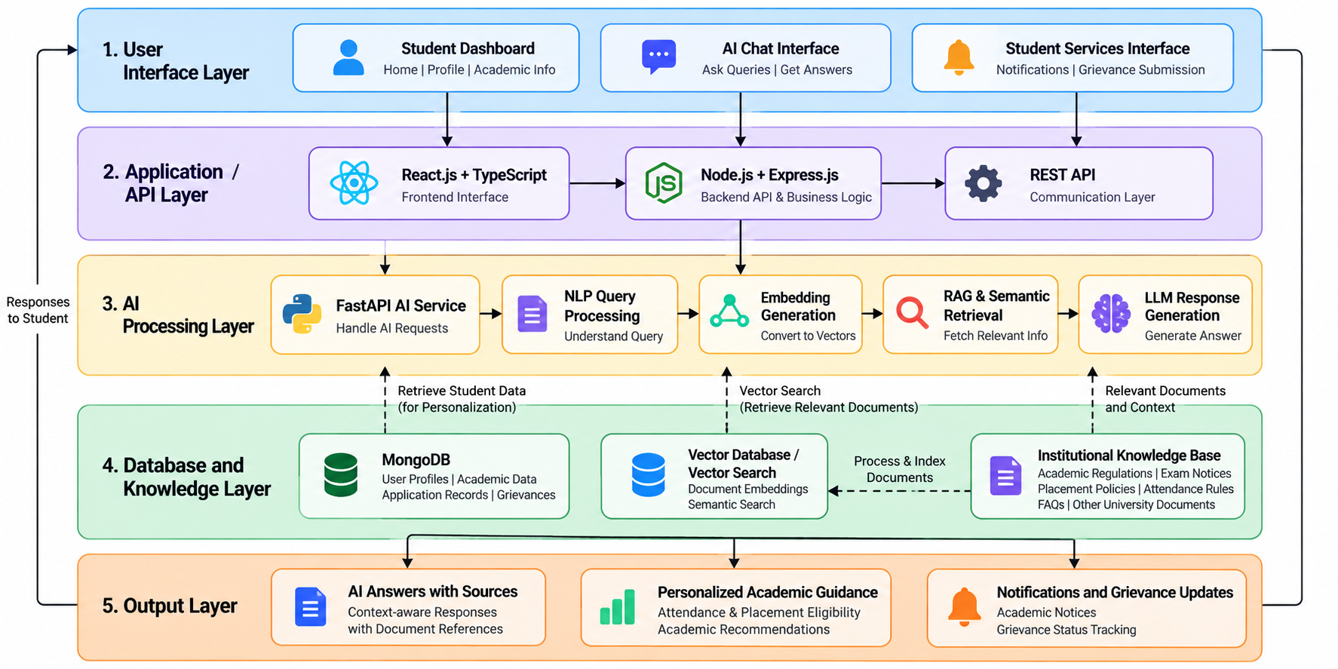
PROPOSED SYSTEM ARCHITECTURE / BLOCK DIAGRAM

Slide 4

MODULE DESCRIPTION
Module 1: User & Profile
Module 3: Academic Guidance
Secure login and authentication.
Manage student profiles.
Role-based access control.
Protect academic information.
Ask questions in natural language.
Retrieve information using RAG.
Generate contextual AI answers.
Provide source references.
Access authorized student data.
Check attendance and eligibility.
Identify pending academic requirements.
Provide personalized recommendations.
6: Grievance Support
Display exam schedules and notices.
Share academic calendar updates.
Send deadline reminders.
Provide verified information.
Display placement guidelines.
Explain company eligibility criteria.
Check eligibility using authorized data.
Provide career-related guidance.
Submit and track grievances.
Access administrative procedures.
Categorize requests by status.
Support staff review and responses.

Slide 5
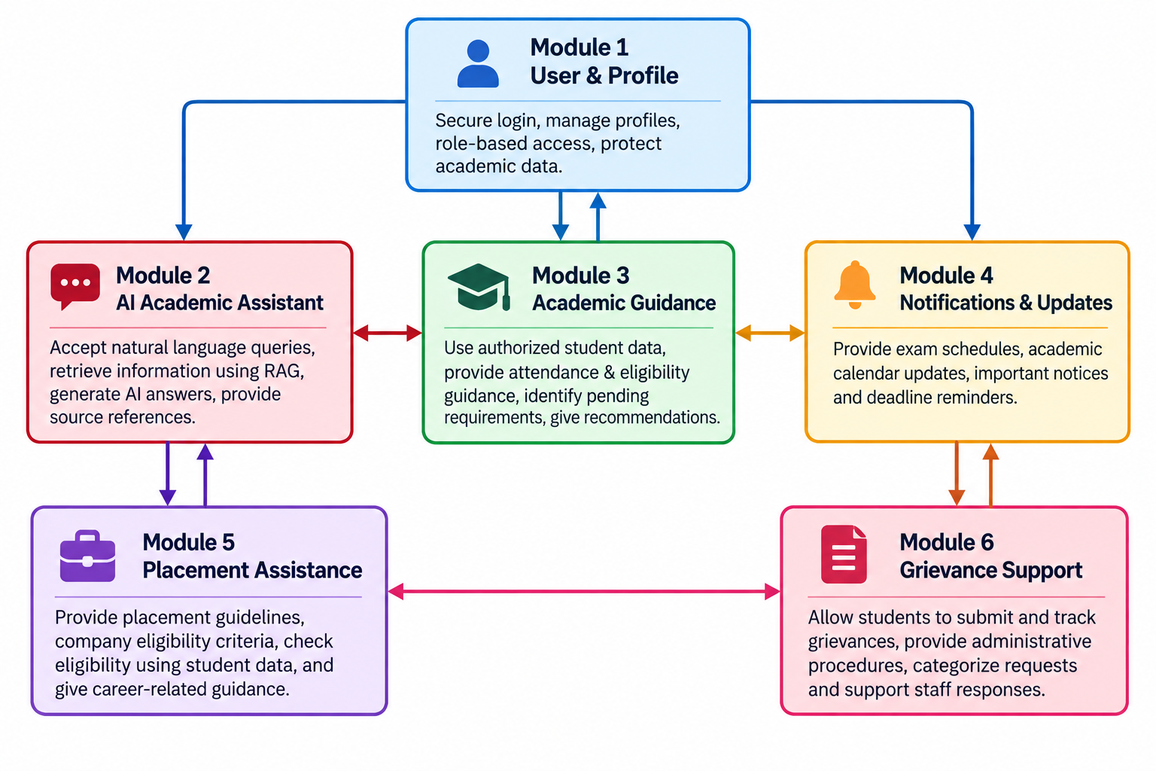
MODULE INTERACTION / DATA FLOW

Slide 6
DATASET DETAILS
Dataset / Source | Type | Size / Records | Features / Attributes | Purpose / Usage
Faculty information | JSON | 4.30 KB | Document ID, name, department, designation, subjects, email | Faculty-related queries
Course information | JSON | 2.63 KB | Document ID, course, semester, credits, faculty | Course and semester queries
Examination schedules | JSON | 3.30 KB | Document ID, subject, date, time | Exam-related queries
Academic calendar | JSON | 1.24 KB | Document ID, event, date | Academic events and dates
Attendance policies | JSON | 0.81 KB | Document ID, policy | Attendance rule retrieval
Placement policies | JSON | 0.72 KB | Document ID, rule | Placement rule retrieval
Campus services | JSON | 1.49 KB | Document ID, service, timing | Service-related queries

Slide 7
DATASET DETAILS
Dataset / Source | Type | Size / Records | Features / Attributes | Purpose / Usage
Holidays | JSON | 0.63 KB | Document ID, holiday | Holiday information
Hostel information | JSON | 0.68 KB | Document ID, rule | Hostel-related queries
FAQs | JSON | 5.16 KB | Document ID, question, answer | Frequently asked questions
Knowledge base total | JSON | 20.94 KB | Multiple fields across 10 JSON files | Institutional information retrieval
Training queries | CSV | 3.54 KB | Query ID, query, document ID | Retrieval development and evaluation
Test queries | CSV | 1.14 KB | Query ID, query | Unlabelled queries for prediction
Sample submission | CSV | 0.36 KB | Query ID, document ID | Required prediction format

Slide 8
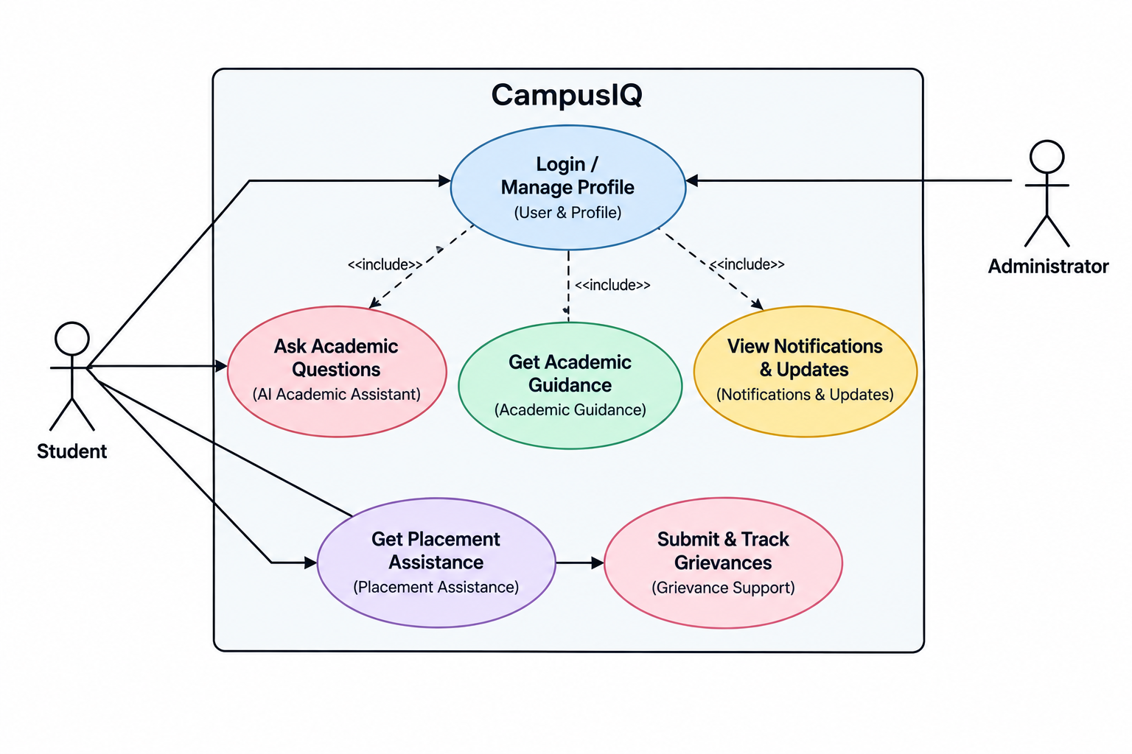
USE CASE UML DIAGRAM

Slide 9
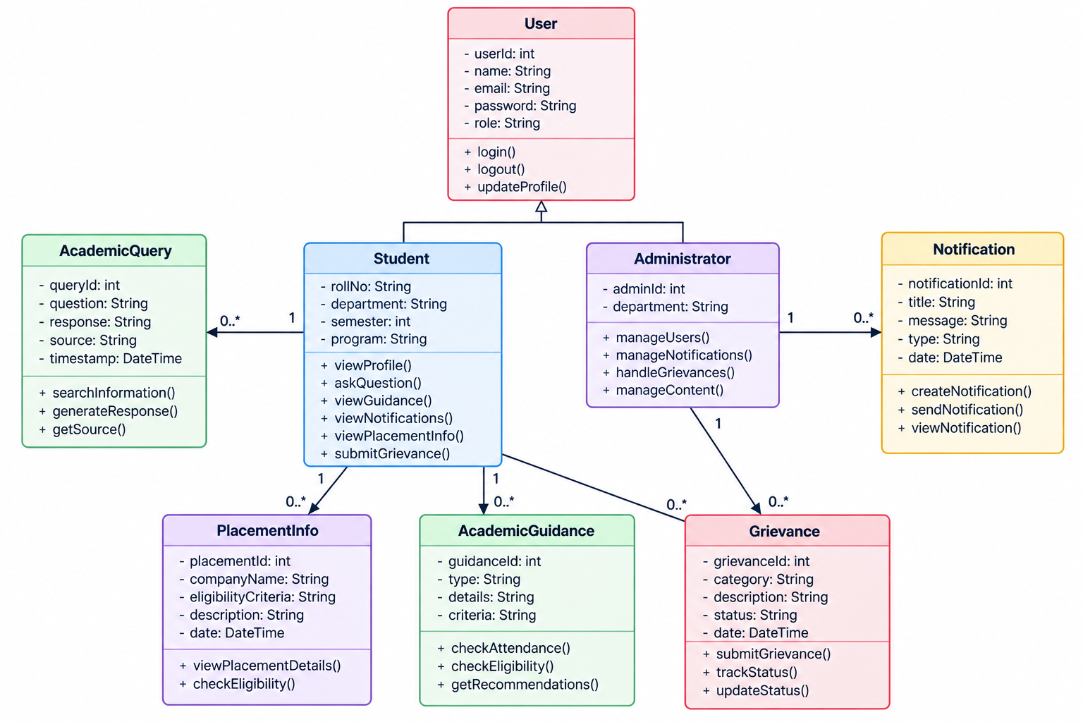
CLASS UML DIAGRAM

Slide 10
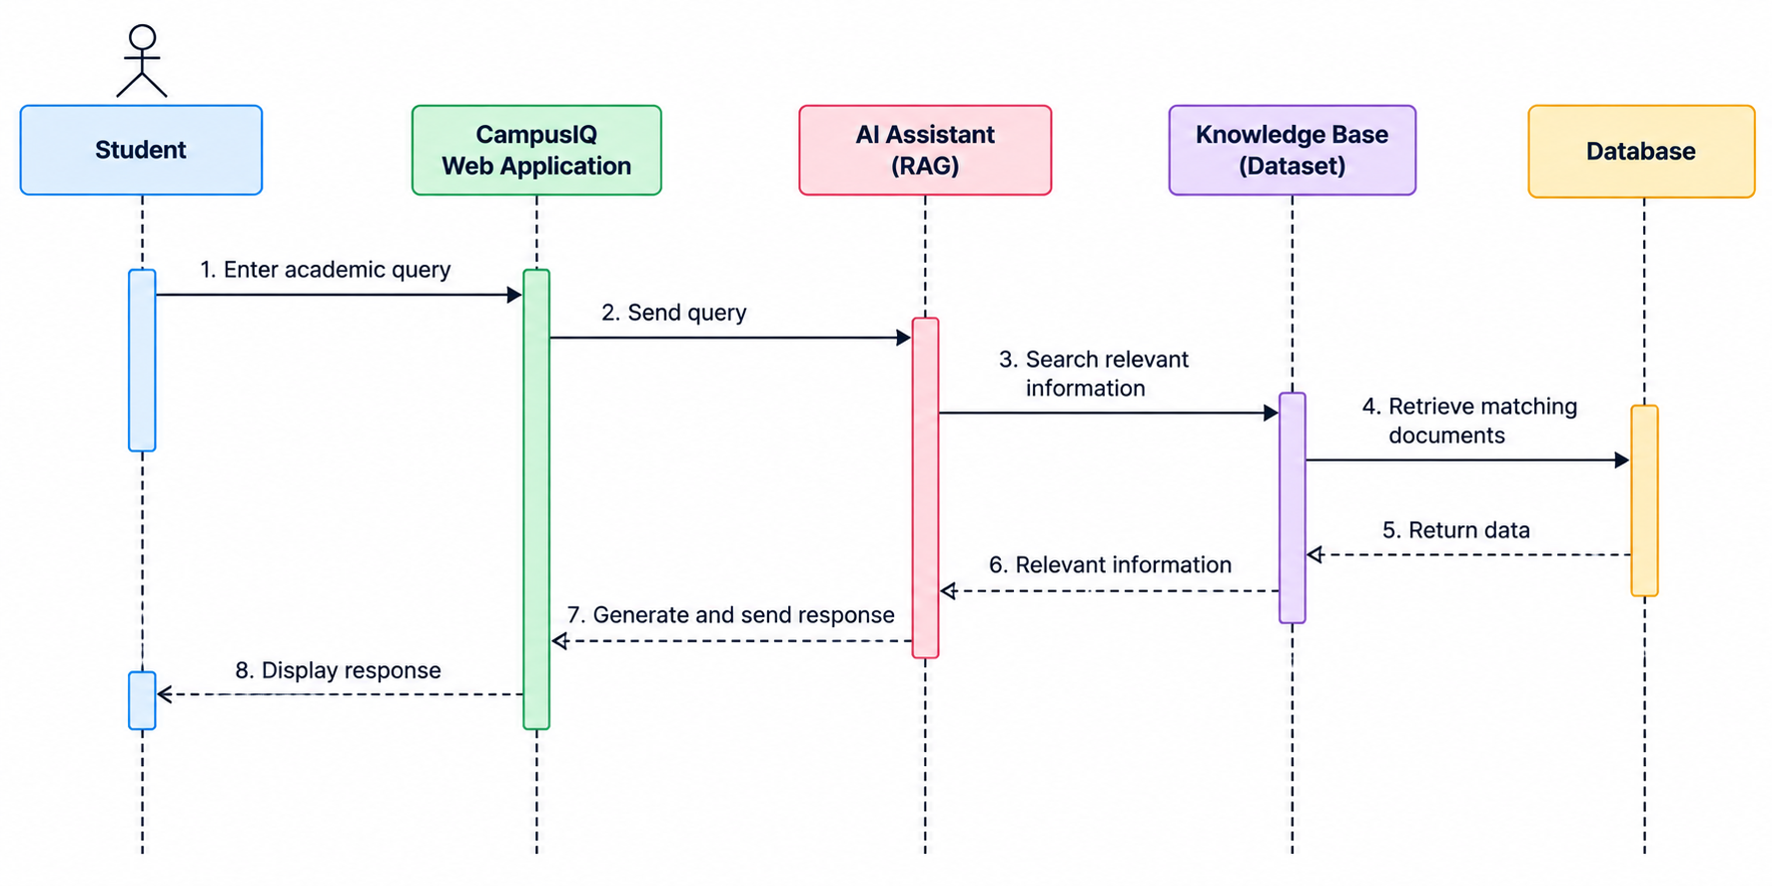
SEQUENCE UML DIAGRAM

Slide 11
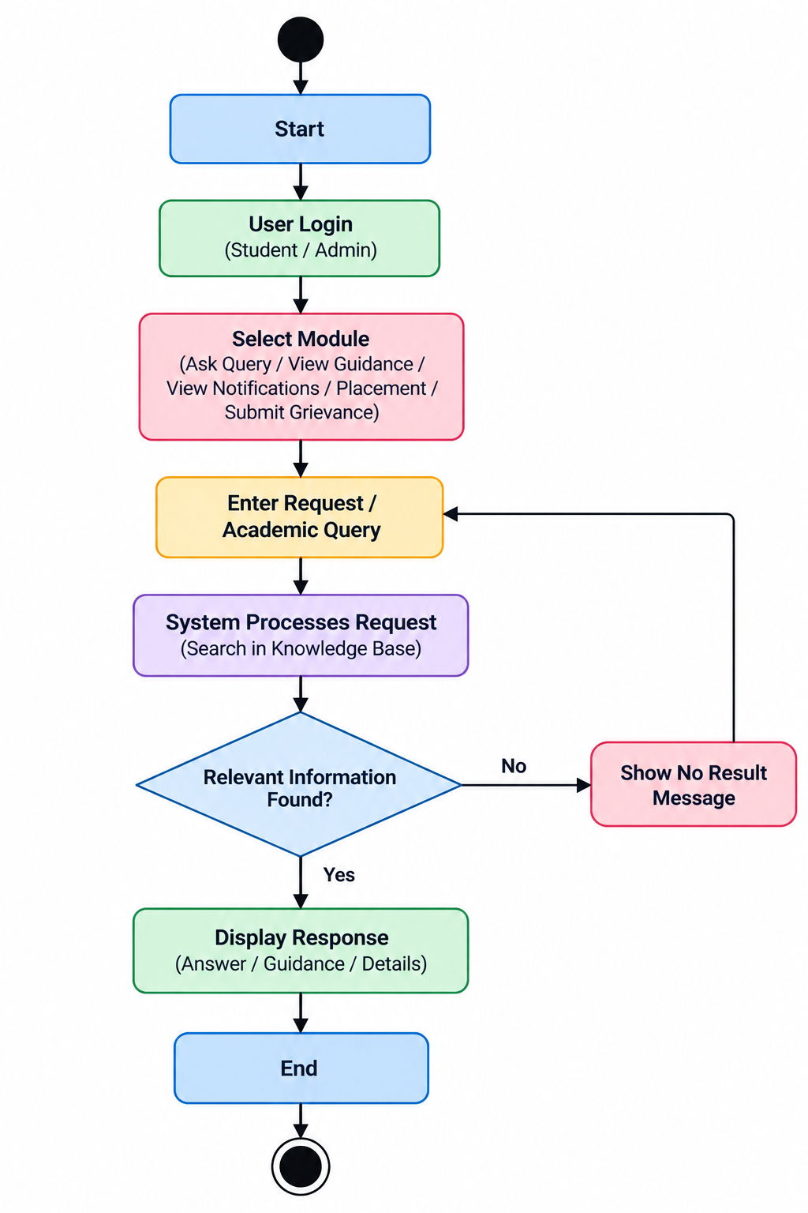
ACTIVITY UML DIAGRAM

Slide 12
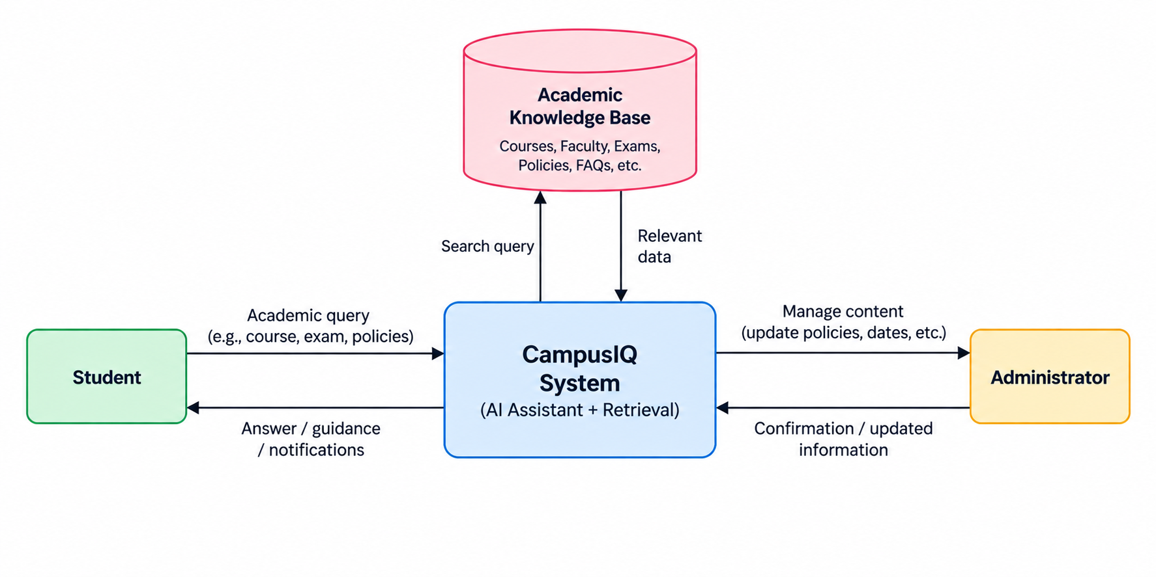
DATA FLOW DIAGRAM

Slide 13
SOFTWARE REQUIREMENTS
Category | Requirement / Technology | Purpose
Operating System | Windows 10/11, Linux or macOS | Development and execution of the platform
Programming Language | JavaScript, TypeScript, Python | Frontend, backend and AI development
Framework / Library | React.js, Node.js, Express.js, FastAPI, LangChain | User interface, REST APIs and RAG-based AI processing
Database | MongoDB, Vector Database / Vector Search | Store user profiles and application data; index embeddings for semantic retrieval
IDE / Development Tool | Visual Studio Code, Postman | Code development, debugging and API testing
Version Control / Other Tools | Git, GitHub, LLM API (OpenAI/Gemini), embedding model | Version control, collaboration, response generation and semantic search

Slide 14
FUNCTIONAL & NON-FUNCTIONAL REQUIREMENTS
Type | Requirement | Priority
Functional | The system shall authenticate students and administrators and enforce role-based access. | High
Functional | The system shall answer academic queries using RAG and provide relevant source references. | High
Functional | The system shall provide personalized attendance and placement eligibility guidance using authorized student data. | Medium
Non-Functional | Performance: The system should return responses within an acceptable time under normal operating conditions. | High
Non-Functional | Security: The system shall protect user and academic data through authentication, access control and secure communication. | High
Non-Functional | Usability / Scalability: The system should provide a simple, responsive interface and support future growth in users and documents. | Medium

Slide 15
KEY DESIGN DECISIONS & JUSTIFICATION
1. Retrieval-Augmented Generation (RAG): Provides context-aware answers grounded in institutional documents, improving relevance and reliability.
2. Natural Language Processing (NLP): Enables students to ask academic questions in simple, conversational language.
3. Semantic Search and Embeddings: Retrieves relevant information even when the query wording differs from the source documents.
4. Modular Architecture: Separates authentication, academic assistance, personalized guidance, notifications, placement, and grievance support for easier development and maintenance.
5. MongoDB and Vector Database: MongoDB manages application and student data, while vector storage supports efficient semantic document retrieval.
6. Role-Based Access Control: Protects student information and ensures users access only authorized academic and administrative data.
7. Personalized, Source-Based Responses: Combines verified institutional policies with authorized student data to provide explainable academic and placement eligibility guidance.

Slide 16
DESIGN PHASE STATUS & NEXT STEPS
Design Phase Status
Finalized project title, problem statement, and objectives.
Completed literature survey on AI chatbots, RAG, and academic information retrieval.
Identified and inspected the candidate academic knowledge-retrieval dataset.
Defined six core modules and their interactions.
Designed the proposed five-layer system architecture.
Prepared UML diagrams: Use Case, Class, Sequence, and Activity.
Prepared the Data Flow Diagram (DFD).
Identified functional and non-functional requirements.
Finalized the proposed software stack and key design decisions.
Next Steps — Implementation Phase
Set up the React.js frontend and Node.js/Express.js backend.
Develop secure login, user profiles, and role-based access.
Build the FastAPI-based AI service using RAG and semantic search.
Prepare and index approved institutional documents.
Integrate the LLM for contextual answers with source references.
Implement personalized academic guidance and placement eligibility checks.
Develop notifications and grievance management features.
Test retrieval accuracy, security, performance, and usability.
Evaluate the prototype and refine the system based on results.

Slide 17
CONCLUSION
CampusIQ: An AI-Powered University Student Support and Academic Intelligence Platform aims to transform the way students access academic information and university support services through the integration of Artificial Intelligence (AI), Natural Language Processing (NLP), Retrieval-Augmented Generation (RAG), semantic search, and Large Language Models (LLMs). The platform is designed to provide a centralized interface where students can obtain academic information, examination schedules, attendance policies, placement guidelines, institutional notices, and administrative assistance through natural-language queries. By combining verified institutional documents with authorized student academic data, CampusIQ aims to deliver personalized academic guidance, attendance and placement eligibility insights, and relevant recommendations based on individual student needs.
The proposed system consists of six major modules: User Authentication and Profile Management, AI-Powered Academic Information Assistant, Personalized Academic Assistance, Notifications and Academic Updates, Placement and Career Assistance, and Grievance and Administrative Support. Its modular architecture promotes maintainability, scalability, and future integration with existing university systems. The use of source-based responses, role-based access control, and appropriate data protection measures is intended to improve the reliability, transparency, and security of the platform. Overall, CampusIQ aims to reduce the time and effort students spend searching for information, improve access to essential academic services, and support more efficient communication between students and university administration. In the future, the platform can be enhanced with multilingual support, real-time integration with university portals, advanced academic analytics, and improved personalization to create a smarter, more accessible, and student-centric university support ecosystem.

